Slide 1
M01 Technology Transfer - Introduction
Trainer Presentation

Slide 2
Content
Key Concepts of Technology Transfer
Types of Technology Transfer
Motivations and Barriers of Technology Transfer
Key Actors in the Technology Transfer Process
Forms of Technology Transfer
Traditional Model of Technology Transfer
Technology Transfer Management

Slide 3
Key Concepts of Technology Transfer

Slide 4
Key Concepts of Technology Transfer
The concept of technology itself:
The first component is a tangible object, such as a product, equipment, process, method or a plan.
The second component is an intangible object, such as knowledge in various areas of management, marketing, production, knowledge from science and research, but also a skilled workforce.
Technology as the output of research and development activities, e.g., an invention, a technical solution or an external treatment of a product.
In general, technology is also defined as an intellectual property that can be used in practice, e.g., software, database and know-how.

Slide 5
Key Concepts of Technology Transfer
The definition of technology transfer not uniformly unified.
From a broader point of view, it can be defined as the transfer of research and development results and knowledge into practice.
From a narrower point of view, technology transfer can be defined as the successful application of technology by one entity so that this technology meets the needs of other entities.

Slide 6
Types of Technology Transfer
Vertical technology transfer.
Horizontal technology transfer.
(Types regarding various forms of technology transfer and various actors participating in technology transfer process).
Linear technology transfer.
Direct technology transfer.
(Types regarding the sequence of individual phases of technology transfer process).

Slide 7
Motivations for Technology Transfer
Technology transfer has positive impact on:
Researchers
Research and Development Institutions
Industry
Society
Benefits for researchers include:
Professional growth and evaluation in the pedagogical and research process.
Creation of new knowledge or development of new technology.
New and strong academic and business partnerships and contacts with industry.
Economic benefits.

Slide 8
Motivations for Technology Transfer
Benefits for research and development institutions include:
Intensified cooperation with industry, thus it multiplies the capacity of the institution.
Creation of new knowledge, technology and intellectual property, which can then be used in pedagogical activities, in research and then commercialization.
Successful technology transfer in effect increases the institution's regional, national, and international credit.

Slide 9
Motivations for Technology Transfer
Benefits for industry include:
Cooperation with universities and participation on technology transfer process with universities can accelerate the development of new technologies and the introduction of new innovative products, services and processes on the market.
Gaining competitive advantage in the relevant market.
Technology Transfer benefits society by:
Improving the structure of funding for science and higher education.
Concentrating financial and knowledge potential in the region.
Increasing the innovation and competitiveness of the region.
Increasing the living standards and quality of life.

Slide 10
Barriers of Technology Transfer
The objectives of the universities, which determine their overall focus and direction of research, and the environment in which universities are located.
Low financial, material and immaterial support for technology transfer from university to industry by the national strategic actors.
Low awareness of the management and the researchers of the university about the benefits of technology transfer.
Insufficient internal rules of the university in the field of technology transfer.

Slide 11
Barriers of Technology Transfer
Shortcommings of technology transfer offices:
fundamental underfunding of their activities.
lack of capable technology transfer managers and personnel.
Insufficient motivation of researcher to participate in the technology transfer process.
Ineffective dissemination and commercialization of new findings into practice.

Slide 12
Key Actors in the Technology Transfer Process
Regional National International Level
R&D Institutions
Public Sector
Industry

Slide 13
Key Actors in the Technology Transfer Process
Technology transfer offices:
Responsible for commercializing institution’s owned technology, knowledge, or intellectual property through the core activities of, e.g., attracting and assessing invention disclosures, choosing the right intellectual property protection strategy, licensing, spin-off or start-up company formation, material sales and managing financial funds.
The technology transfer office’s mission, approach and activities should always be consistent with the institutional mission and activities.

Slide 14
Key Actors in the Technology Transfer Process
Technology transfer office personnel:
May be outsourced.
Technology transfer managers, who are capable to engage with researchers and entrepreneurs and understand both academic and business side of technology transfer.
Technical or natural science specialists.
Legal and intellectual property advisors
Administrative staff.

Slide 15
Forms of Technology Transfer
Technology commercialization
By its owner
Through assignments
By business partnerships

Slide 16
Forms of Technology Transfer
Technology is generally commercialized by its legal owner in cases when:
The owner already has enough capabilities for marketing and exploitation.
The owner does not have enough capacities for building up and/or carrying out business partnership needed for such exploitation.
The owner hesitates to share information with third parties or does not want to create possible competitors in the relevant market.

Slide 17
Forms of Technology Transfer
Assignment - a technology, knowledge or any intellectual property assignment is a transfer of ownership of such technology, knowledge or intellectual property right from its rightful owner to another party.
Licensing - a license is a contract under which the owner of the technology, knowledge and/or other intellectual property (a licensor) grants permission for the use of its assets to another party (a licensee) within the limits set by the provisions of the contract. A license allows the licensor to make money from its asset by charging the licensee in return for its use.

Slide 18
Forms of Technology Transfer
License
Non-exclusive
Exclusive
Sole

Slide 19
Forms of Technology Transfer
Franchising - a special type of licensing, enabling the replication of the owner’s (franchisor) business concept in another location by providing continuous support and training to the recipient (franchisee).
Joint ventures - are business alliances of two or more independent organizations (venturers) to undertake a specific project or achieve a certain goal by sharing risks.
Spin-offs, start-ups - are separate legal entities created by a parent organization to bring its intellectual property assets into the market.

Slide 20
Forms of Technology Transfer
Legal contracts regulating cooperation of universities with industry:
Inter-institutional agreement
Non-disclosure agreement
Material transfer agreement
Consulting agreement
Laboratory-services agreement
Research and license agreement
Memorandum of Understanding

Slide 21
Traditional Model of Technology Transfer
There is no single model that can capture all the elements of technology transfer and that can be applied in all circumstances.
This model is characterized by a series of interdependent and interconnected phases leading to the commercial evaluation of research results.
The technology transfer phases as illustrated by this model do not have to actually take place in the order and line captured in it.

Slide 22
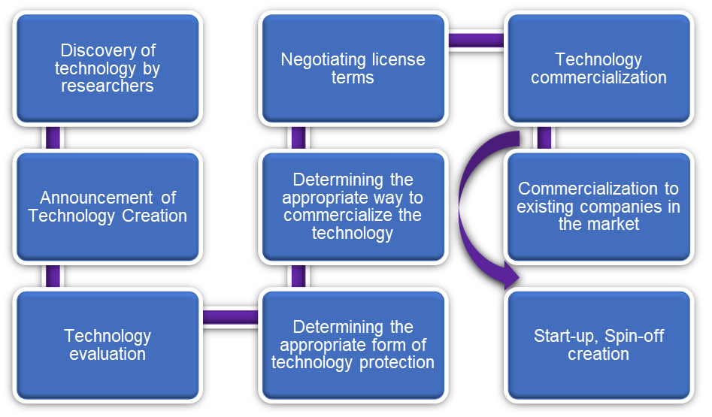
Traditional Model of Technology Transfer

Slide 23
Traditional Model of Technology Transfer
Enforcement of intellectual property rights is important.
Only a part of the new knowledge that is generated by universities can be defined as an invention.
Only a small number of inventions will be licensed (or otherwise evaluated).
This traditional technology transfer model stands and falls on a small percentage of new technologies originating from research in universities and pays little attention to the rest.

Slide 24
Technology Transfer Management
Reasons for unsuccesfull technology transfer:
The mission and objectives of the universities (or other Research & Development institutions), which determine the overall focus and direction of research and the links between these universities and industry.
Difficulty of bringing advanced technologies to market.
Commercialization may take too long for technologies that are technically significant but not economically/commercially significant.
Low flexibility of universities, cultural barriers between these institutions and industry and concerns that industry links with universities will have negative impact on academic freedom.

Slide 25
Technology Transfer Management
Factors supporting technology transfer:
Greater rewards for involving researchers in the technology transfer process.
An environment with a concentration of high-tech companies.
The experience of technology transfer staff.
Stronger links between universities and industry, and the legislative environment.
Academic entrepreneurship, collaboration and activities carried out in an open innovation environment.

Slide 26
Technology Transfer Management
Different objectives of Universities and Industry:
Universities are not at the forefront of production or business activities and are more focused on education, the promotion of knowledge through basic and applied research, and the dissemination of this knowledge to the public.
Universities focus more on the transfer of the technology to industry, in order to at least cover the costs that went into the creation, research and development of this technology.
Businesses aim to gain any competitive advantage by focusing on the development, production and/or sale of a particular type of product or service in a particular market.

Slide 27
Technology Transfer Management
Cooperation of universities and industry:
the use of external resources for the development and use of technology within the organization, whether it is a university or a company.
the use of proprietary technology by external entities to accelerate the development or commercialization of that technology.
a combination of the previous two points, which means that organizations do not want to share existing resources and knowledge but do want to work together, collectively, to develop new solutions and technologies.

Slide 28
Technology Transfer Management
Phases of intellectual property assets management:
Research and development of technology and protection of intellectual property. Companies spending on R&D must decide to choose the right strategy at this stage.
Commercialization of intellectual property. Commercialization strategies at universities differ from those of the business sector, as universities are not directly involved in the development, production and sale of products and services. R&D businesses identify the specific intellectual property strategy needed to engage with a particular economic sector or market, in order to optimize intellectual property for specific business purposes and objectives.

Slide 29
Conclusion
Technology transfer has undoubtedly a positive impact on all stakeholders participating in the technology transfer process.
Technology transfer supports the development of the early-stage technology in a broader sense, into products, processes and services that can be used by the market and public in general.
Technology transfer promotes collaborations between various stakeholders, in order to advance the knowledge in a particular field or to further develop a technology.

Slide 30
Conclusion
Successful technology transfer provides for great economic benefits and incentives resulting from successful commercialization of the technology, as it can accelerate the development of new technologies and the introduction of new innovative products, services and processes on the market.

