Slide 1
M03 Assessment of feasibility
Trainer Presentation

Slide 2
A feasibility study (sustainability, technical-economic study) provides all the data and information needed for an investment decision.

Slide 3
A research project is a scientific endeavor to answer a research question
Case series
Case control study
Cohort study
Randomized, controlled trial
Survey
Secondary data analysis such as decision analysis, cost effectiveness analysis or meta-analysis

Slide 4
The feasibility study is a tool for justifying the project proposal, especially from an economic and technical point of view.
Its aim is to verify whether:
the best possible option was selected and the necessary funds for the implementation of the project were accurately estimated,
the long-term sustainability of the investment has been demonstrated,
risks have been identified.

Slide 5
The 3 parts of feasibility study
Technology Considerations
Product or Service Marketplace
Identification of Specific Market

Slide 6
Types of feasibility studies
Technical feasibility
Economic feasibility
Operational feasibility
Legal feasibility
Schedule feasibility
Project scope
Current analysis
Requirements

Slide 7
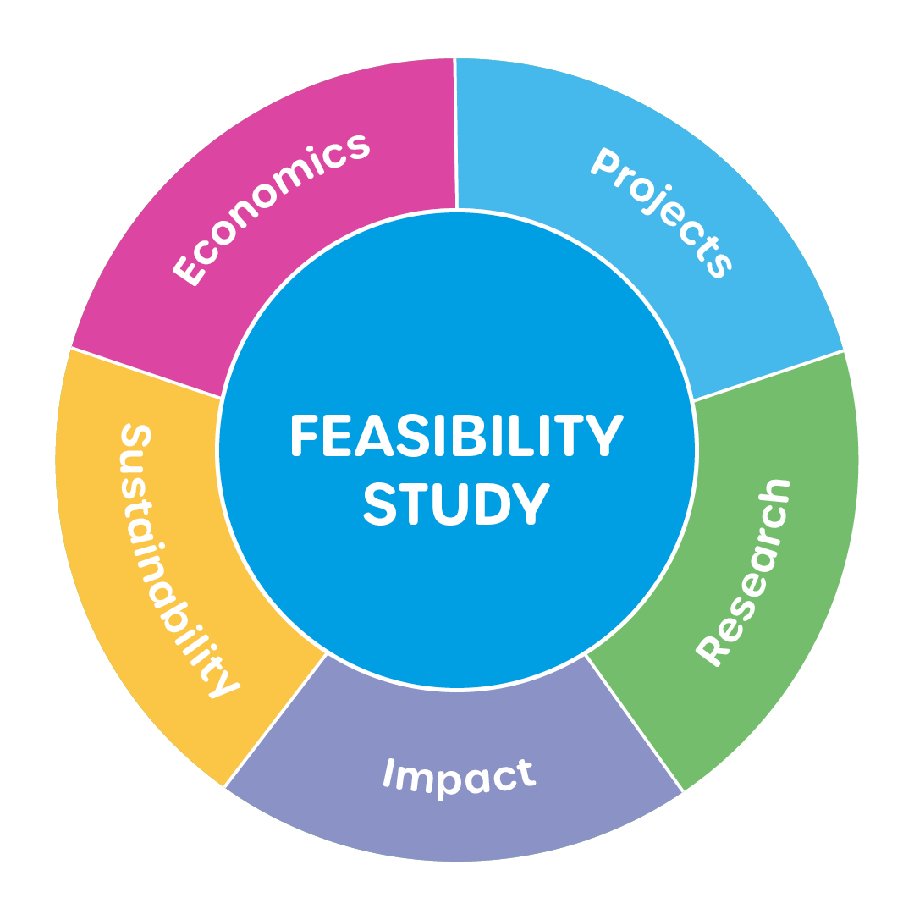
Factors of feasibility study
https://wasserdreinull.de/en/our-offers/testcenter-and-servicelab/feasibility-studies/

Slide 8
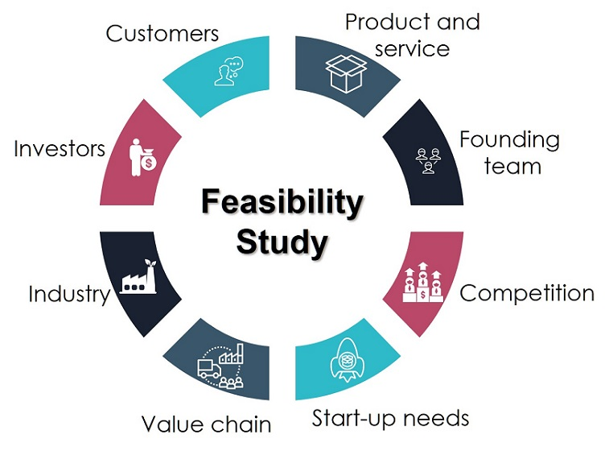
Factors of feasibility study
http://espigaexports.com/feasibility.html

Slide 9
The proof of concept
Proof of concept (POC), also known as proof of principle, is a realization of a particular method or idea to demonstrate its feasibility or a demonstration in principle to verify that some concept or theory has practical potential.
A proof of concept is usually small and may or may not be complete.

Slide 10
Five Proof of Concept steps
Step 1:
Prove the need: Do people really need your product? Why?
Before you start thinking about the details of your solution, you should first invest your time and energy in thoroughly researching the specific problems of your target group, or different segments of it.
Identify the problem you want to solve.
Think about what groups of people are affected by this problem. Define the problems that people are facing and think honestly if this is really something that needs to be solved.

Slide 11
Five Proof of Concept steps
Step 2:
Connect problems and solutions Brainstorm with your team on possible approaches to solving the problems you identified in the previous step.
When you come up with several proposed solutions for each problem, think about their technological feasibility, the unique value they are supposed to bring, the necessary costs and the time required.
The result of this step should be a list of problems linked to a list of best solutions, all of which are feasible and useful enough to be worth including in the final product.

Slide 12
Five Proof of Concept steps
Step 3:
Get feedback on practical benefits. Go back to your target audience and walk through the solutions you came up with to verify that they actually deliver the desired value. Is this really an effective solution to the given problems?
Are your solutions practical, useful and convenient?
Test your assumptions thoroughly and try not to be swayed by your own enthusiasm for your solution.
If your draft turns out to be unhelpful to the bullseye, take a step back.

Slide 13
Five Proof of Concept steps
Step 4:
Cover the practicalities.
Before proceeding further, you need to carefully consider the technical feasibility and financial sustainability of your solutions.
Think about the capabilities and capacities that will be needed, the source of income, the pricing policy and the promotion of the final product.
Try to get to the bottom of all obstacles before taking the next step.

Slide 14
Five Proof of Concept steps
Step 5:
Learn and prepare for prototyping.
The main purpose of doing a Proof of Concept is to get useful feedback.
Learn as much as possible for the next expensive phases of design and product development.

Slide 15
Proof of Concept at UHK
The University of Hradec Králové received financial support from the Technology Agency of the Czech Republic for the GAMA 2 programme.
The aim of this project is to support systems for the transfer of knowledge of science and research financed from public sources in research organizations and their successful application in practice.
Realization date: 01.01.2020 - 31.12.2022.
The total amount of support from the Technology Agency of the Czech Republic for the GAMA 2 programme: 850 440 EUR.

Slide 16
Proof of Concept at UHK
A total of 38 projects were registered under the GAMA 2 programme.
Overall 15 Proof of Concept (PoC) sub-projects were approved by the UHK Commercialization Council for implementation and being implemented within the GAMA 2 programme.
Currently, 7 PoC sub-projects are implemented within the GAMA 2 programme and 8 PoC sub-projects were finished in 2021.
8 projects are from the Faculty of Informatics and Management.
7 projects are from the Faculty of Science.

Slide 17
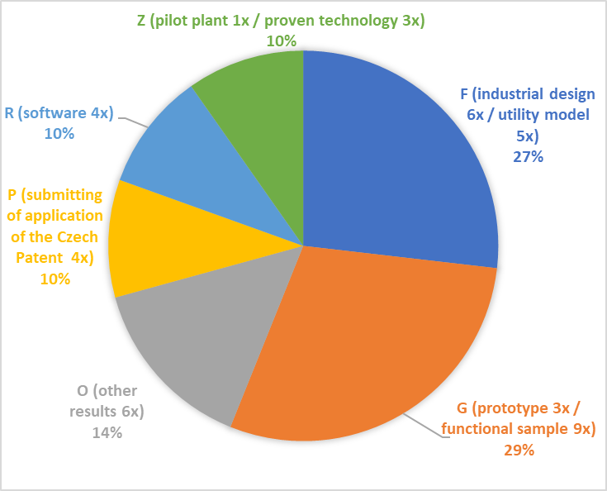
Expected outputs PoC at UHK

Slide 18
Finance and duration of PoC projects at UHK
Average costs for a sub-project – 55 367 EUR
Average length of sub-projects – 1.5 years
Duration of the shortest project – 8 months
Duration of the longest project – 24 months

Slide 19
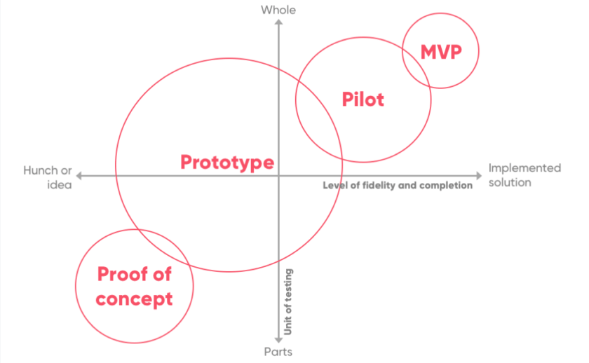
Proof of concept-pilot test-prototyping
https://states-of-change.org/stories/proof-of-concept-prototype-pilot-mvp-whats-in-a-name

Slide 20
Conclusion
Feasibility studies can identify the logistical, financial, and market challenges of a proposed project by evaluating: What the estimate would be to fund the project? When will the potential business offer a return on investment? What is the market for the proposed product or service?
Proof of concept activities: these are activities carried out with a result of UHK research and development, which lead to practical, at least partial, verification of the contribution and practical function of the result of research and development, or which lead to an increase in the quality and thus also in the value of the information about the given result of research and development.

