Slide 1
M01 Introduction to patent search and analysis
Trainer Presentation

Slide 2
Content
Property protection system
Patent search
Patenting Management
Database of patents

Slide 3
Why to conduct a patent search?

Slide 4
When writing your description, include the following information:
Purpose: What does the invention do?
Application: What is it used for?
Structure: What is the invention made of and what are its parts?
Function: How does it work?
Consumers: Who could benefit from its use?

Slide 5
Sources of non-patent information
general encyclopedias,
technical or scientific encyclopedias,
articles in research journals,
technical reports and working papers,
trade catalogues where you can find similar items for sale.

Slide 6
Keep the following in mind
Try to determine where your device or technology will be used.
What existing items will replace your invention?
Which consumers would buy your invention? Name consumer groups, professions, industries, etc., that might want or need your invention.
Where do consumers generally purchase equipment or consumables, i.e., what you have invented? Would this be a potential marketing outlet for your invention?

Slide 7
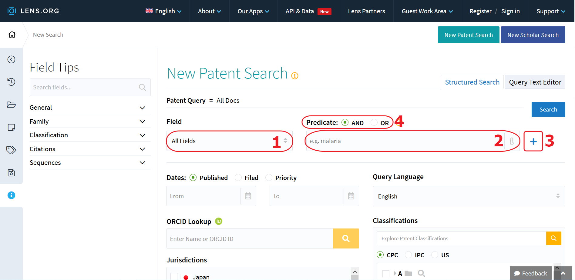
LENS.ORG Tool

Slide 8
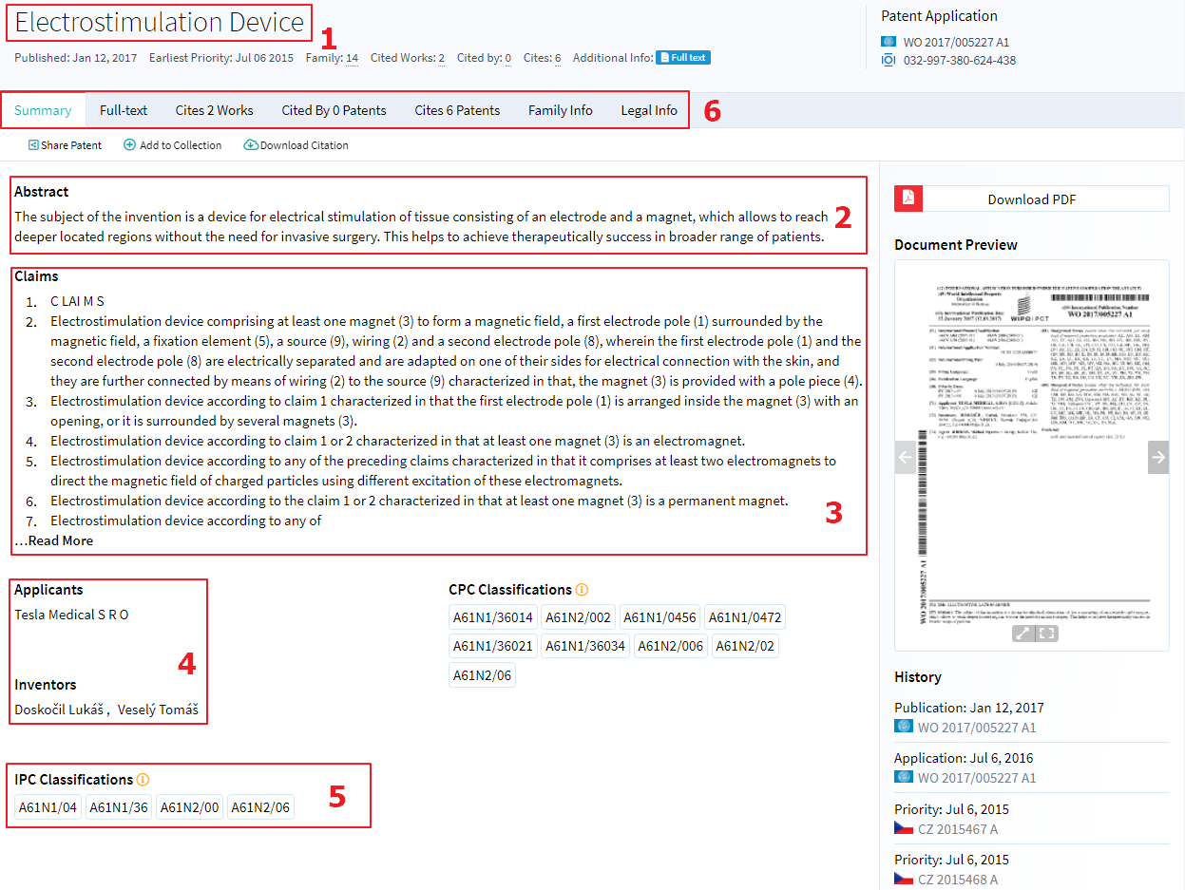
Content of the patent record

Slide 9
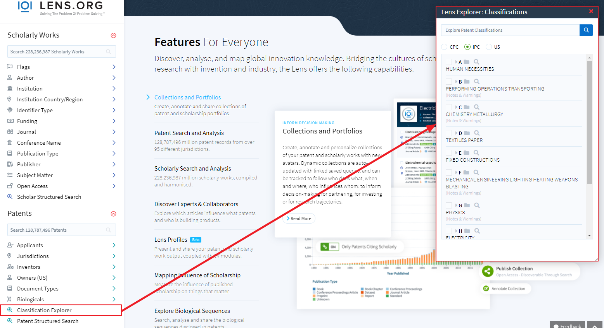
Search using IPC classes

Slide 10
Using logical operators in search
Logical operators (AND, OR, ANDNOT, XOR)
Neighboring or approximation operators (NEAR)
Truncation: the primary root using an operator called a wildcard, usually an asterisk (*), question mark (?), dollar sign ($), or percent sign (%)
Nesting: using parentheses () to organize a search
Phrase: the use of quotation marks «» to surround a single search

Slide 11
ESPACENET
Web page:
https://worldwide.espacenet.com/
Patent – search for free in Espacenet
90+ million documents
User friendly

Slide 12
Conclusion
Effective provision, management and exploitation of industrial property rights is key to developing the potential in the area of ​​research, development and innovation, which is essential for long-term competitiveness.
System provides, in addition to securing the exclusive right to use intangible property, also the opportunity to get to know each other with the latest technical knowledge.

