Slide 1
M05 Commercialization – spin-off
Trainer Presentation

Slide 2
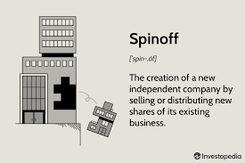

Slide 3
What does spin-off mean?
What is a spin-off example?
What does spin-off mean in shows?
What is another word for spin-off?

Slide 4
Spin-off is a new business created by separating part of a parent organisation.
Merriam-Webster defines spin-off as the distribution by a business to its stockholders of particular assets and especially of stock of another company and also as the new company created by such a distribution.
spin-offs are organisational units, companies that are created based on the separation of a certain activity or group of people from the primary organisation. A university can also be such a primary organisation. At the same time, however, it is true that the primary organisation generally maintains a dominant influence on the activities of the newly founded organisation.

Slide 5
Spin-offs, which are set aside at a university or a research and development organisation of the state sector, are created for the purpose of commercialising the results of research and development.
A spin-off usually refers to a separate company established in order to bring a technology or other invention developed by a parent organisation to the market. A conventional spin-off company can be created through the separation from a parent organisation which contributes with its financial, human and intellectual capital. The mission of such spin-off is mainly to further develop and commercialise the technology created at and assigned by the parent organisation.

Slide 6
University - Motivation for spin-off creation
Need to bring technology to market
Encourage student entrepreneurship
Support local employment
Need to generate revenue
Reputation

Slide 7
Spin-off vs start-up
One of the first significant differences between a spin-off and a start-up is linked to their origin – the creation of a spin-off takes place within another organisation, which can be a firm, an academic institution or a research institute – in our case it is the university.
Start-ups are also born from innovative business ideas, but, unlike spin-offs, they are not created inside an institution. They tend to exploit a market niche with great potential.

Slide 8
The establishment of spin-off
Source: https://vubtechtransfer.be/en/how-to-start-a-spin-off-company

Slide 9
Technology transfer officers should be the first point of contact for initial exploratory discussions between academic staff, researchers and students about the possibility of commercialising research and setting up a spin-off.
University Science Parks also play an important role in stimulating spin-off creation.
Business Incubators are organisations that provide a wide range of support programmes to help turn ideas into thriving businesses. Universities that operate their own business

Slide 10
 | Spin-off | Start-up
Origin (Created by) | University | Outside University
Technology / IP | Owned by University | Developed and owned by start-up or licensed to start up by University
Managed by | University Staff | Outside University
Table Spin-off vs Start-up Resource: WIPO
All spin-outs are start-ups but not all start-ups are spin-outs.

Slide 11
The life cycle of start-up companies
Early Stage, Pre-seed stage
Growth phase
The maturity phase, sometimes also referred to as the start-up phase or creation phase

Slide 12
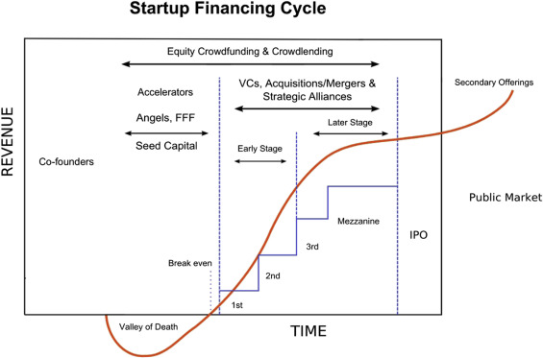
https://www.sciencedirect.com/topics/engineering/valley-of-death.

Slide 13
Spin-off and business plan
It is necessary to attract the attention of external investors.
Formally secure an agreement between the founders of a spin-off economic entity (difficult negotiations in an academic environment). including the future development of the company.
Set rules regarding liability and profit sharing.
It reveals the necessary compromises.

Slide 14
Spin-off and business plan
Before and shortly after they are founded, there is usually "no" marketable product Cannot be financed by previous sales.
Cash flow is influenced by a number of factors (development time and costs, sales volume, profit margin...). It is largely influenced by technology.
Research-based companies (e.g. biotechnology-oriented f.), profitability approx. up to 15 years.
Businesses based on development (e.g. companies focused on electronics), profitability approx. from the 7th year of establishment.
Businesses based on product production (SW companies), profit approx. from the 3rd year.

Slide 15
Death Valley curve
The Valley of Death in Markham et al. (2010).
Source: Wiley Online LibraryWeb of Science®Google Scholar
https://www.investopedia.com/terms/d/death-valley-curve.asp

Slide 16
Spin-offs addressing existing industry problems with a real commercial potential have a higher chance of success and will also help in securing funding from investors.
Important aspect to the spin-off creation is to establish a motivational environment that increases the awareness of commercialising research results amongst researchers and also to allow researchers gain essential entrepreneurial skillsets for setting up and participating in spin-offs.

Slide 17
Positions in the spin-off company
Researchers and or students may hold the following positions in the spin-off company:
partner/associate - depending on a legal form of spin-off company, researcher and or student would be a co-owner of such company by investing financial capital in this spin-off upon its establishment;
executive manager - this person would act on behalf of the spin-off company and would be authorised to perform certain legal actions;
employee - researcher and or student would have specific rights and obligations based on an employment contract, which could be full-time or part-time or based on a different agreement, which could depend on the performance of work, on work activities, or for example on part-time work of students;
external expert - researcher and or student would perform individual activities according to the agreement based on a specific contract.

Slide 18
Impact and Risks
RISK | IMPACT
Assignment of IP to spin-off | If value of IP decreases, it will have a direct impact on the capital of spin-off (decrease of value on balance sheet).
Conflicts of interest – researcher not having sufficient time to commit to spin-off activities | Negative impact on spin-off development that can lead to failure to commercialise.
Lack of early-stage funding | Spin-off will not be able to fund core activities which can result in slower development or in overall failure.
Over-reliance on parent institution (university) | University will be able to support fewer spin-offs due to having to support existing portfolio. This could lead to missing out on opportunity to support more innovative spin-offs.
Lack of support from regional/national governments to support spin-off activities | Low awareness of entrepreneurial opportunities and lack of motivation to commercialise within researcher community - decrease in number of spin-offs.
Administrative burdens of internal university policies | Demotivation of researchers to get involved in commercialisation process.

Slide 19
Conclusion
University spin-offs are seen as an increasingly attractive way of commercialising university intellectual property, boosting innovation and are also being considered to have the potential to bring significant impact on regional economic and social development.
Setting-up a spin-off in academic area is a complex and challenging process often involving lots of different stakeholders with conflicting interests and requiring a supportive national legislative, financial and administrative framework.
Setting up a spin-off is an iterative process, during which one has to constantly (re-)evaluate earlier decisions based on new information.

