Slide 1
M09 Technology transfer process at the University of Hradec Kralove
Trainer Presentation

Slide 2
Technology transfer process at the University of Hradec Kralove – the most important document
Rector's Decree 17/2020 and subsequent internal regulations of the University of Hradec Kralove.

Slide 3
R&D is therefore typically characterized by the need to meet five basic criteria:
it must contain an element of novelty,
it must be creative,
it must contain an element of uncertainty,
it must be systematic,
it must be transferable and/or reproducible.

Slide 4
Motivations for Technology Transfer
Technology transfer has positive impact on:
Researchers
Research and Development Institutions
Industry
Society
Benefits for researchers include:
Professional growth and evaluation in the pedagogical and research process.
Creation of new knowledge or development of new technology.
New and strong academic and business partnerships and contacts with industry.
Economic benefits.

Slide 5
Types of Technology Transfer
Vertical technology transfer
Horizontal technology transfer
(Types regarding various forms of technology transfer and various actors participating in technology transfer process).
Linear technology transfer
Direct technology transfer
(Types regarding the sequence of individual phases of technology transfer process).

Slide 6
Key Concepts of Technology Transfer
The concept of technology itself:
The first component is a tangible object, such as a product, equipment, process, method or a plan.
The second component is an intangible object, such as knowledge in various areas of management, marketing, production, knowledge from science and research, but also a skilled workforce.
Technology as the output of research and development activities, e.g., an invention, a technical solution or an external treatment of a product.
In general, technology is also defined as an intellectual property that can be used in practice, e.g., software, database and know-how.

Slide 7
The following stakeholders are involved:
Originator
OSKT - a coordinator of the whole process
The Intellectual Property Evaluation
Committee Commercialization Board
Rector

Slide 8
Technology Transfer Office
Responsible for commercializing institution’s owned technology, knowledge, or intellectual property through the core activities of, e.g., attracting and assessing invention disclosures, choosing the right intellectual property protection strategy, licensing, spin-off or start-up company formation, material sales and managing financial funds.
The technology transfer office’s mission, approach and activities should always be consistent with the institutional mission and activities.

Slide 9
Creation and notification
1. The originator produced an R&D result that the originator believes could be commercialized, or at least should be protected.
Check and proposal
3. The Administrator of Science and Research projects carries out a formal check and registers it.
Assessment
5. Upon inclusion on the agenda of the Evaluation Committee, the Committee makes a recommendation to exercise or not to exercise the UHK right. In the latter case, it shall propose an appropriate form of intellectual property protection.
2. The originator notifies in writing the creation of the result to OSKT by submitting the Notification Form of the Result of Research and Development to the Administrator of Science and Research projects. A sample table is provided for completion.
4. The TTO then considers the inclusion of the result on the agenda of the Evaluation Committee on the exercise of rights to the R&D result.
Decision
6. Based on the recommendation of the Evaluation Committee, the Rector will decide on the exercise of the rights of the UHK to a given result. In the case of an improvement proposal, s/he will do so within 2 months at the latest, in other cases within 3 months.
Recording the result
7. The originator will create a result record in the Personal Bibliographic Database (PBD) if required at this stage.

Slide 10
Decision on commercialization
1. Convening a Commercialization Board to consider the proposal.
Commercialization project
3. Within 2 months of the Rector's positive decision, the commercialization project is prepared.
Agreements
4. This is followed by the creation of a cooperation agreement and an agreement for the use of the results.
2. If the Board decides to commercialize, the Vice-Rector for Research and Creative Activities will approach eligible persons to develop a commercialization project.
5. The originator is invited to conclude a cooperation agreement with UHK and to cooperate in the preparation of the agreement on the use of the results (UHK and the other party, if any).
6. The agreements are checked by the lawyer, approved by the Vice-Rector and forwarded for the Rector's signature.
7. The signed agreements are handed over in original to each party.

Slide 11
The process itself
Once an employee has achieved a research and development result that s/he believes may be commercializable, or at least should be protected (so as not to alienate an idea that may be transferable in the future),
S/he must notify the TTO in writing of the creation of such a result by submitting a fully completed form entitled "Notification of the R&D Result" ("Notification").
The employee has a duty to the employer to notify this and becomes the originator of the result. The main part of the form is in the form of a table:

Slide 12
Diagram of the sequence of steps after the creation of the result
Creation of the R&D result
1. Creation of the R&D result.
7. The Committee's/ Vice-Rector´s recommendation, including the proposed form of intellectual property protection, was forwarded to the Office of the Rector of the UHK.
8. The Rector will decide whether the UHK will exercise the rights to a given result.
6. The Committee will assess the quality of the reported R&D result and make recommendations.
5b. Results not planned in the project:
Proposal and possible convening of the Committee by the Vice-Rector for Science and Creative Activities.
5a. Results planned in the project:
Proposing an appropriate form of intellectual property protection on the recommendation of the Vice-Rector for Science and Creative Activities. (Step 7 below).
3. The notification shall be sent by the originator to the OSKT.
2. Notification of the R&D result.
4. Formal check of the Notification and assignment of the registration number.
9. The originator shall report the result in the PBD if required.

Slide 13
A chart of commercialization steps
The Rector decided to exercise the right of the UHK to a given R&D result
1. Convening the Commercialization Board and submitting R&D results for consideration.
7. The agreements and attached documents approved by the Vice-Rector for Science and Creative Activities forwarded to the Rector's Office.
8. The agreements signed by the Rector of the UHK forwarded to the legal department, registration at OSKT, transfer to the originators or partners.
6. Submission of a formally checked agreement to the Vice-Rector for Science and Creative Activities.
5. Call for the originators to conclude a cooperation agreement and cooperation in the preparation of the agreement on the exploitation of results.
3. The commercialization project will be ready within 2 months from the time of the Rector's positive decision on the exercise of the right of the UHK.
2. In the case of the Commercialization Board decides on commercialization, addressing persons to develop a commercialization project.
4. Creation of the agreements on cooperation and exploitation of results. Subsequently, legal check.

Slide 14
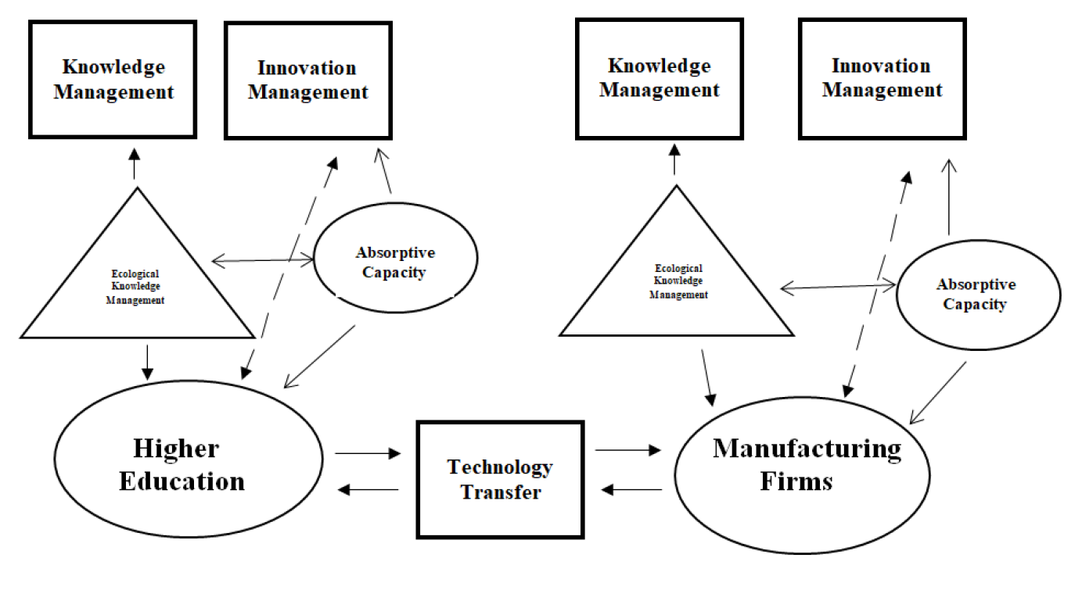
Relationship between knowledge management and TT
adapted from (Anderton & Watson, 2018)

Slide 15
Creative Activities and Knowledge Transfer Office at UHK
Organises and coordinates activities related to the creative activity and knowledge transfer administration at the UHK.
It provides project support in research and development.
It coordinates activities in the field of intellectual property protection and commercialization of results.
It provides the administrative routine of the Scientific Board UHK.

Slide 16
Conclusion
Successful technology transfer provides for great economic benefits and incentives resulting from successful commercialization of the technology, as it can accelerate the development of new technologies and the introduction of new innovative products, services and processes on the market.
At UHK, the technology transfer support system works successfully, the most important document is Rector's Decree 17/2020 and subsequent internal regulations of the University of Hradec Kralove.

